Slide 1
FLEET User Manual
July 1, 2012

Slide 2
Part One – User Names & Passwords
User Names & Passwords
Creating an Account
Forgot Password
Updating Email Addresses or Passwords
Logs
Monthly Bulk Logs
Single Equipment Logs
Work Orders/PM’s
With Bulk Logs
With Manage/View Equipment
With Activities tab (ACS & DOT only)

Slide 3
1. User Names & Passwords
Creating an Account (4-15)
Forgot Password?
Updating Email addresses or Passwords

Slide 4
A. Creating an Account
Click Setup a New Account

Slide 5
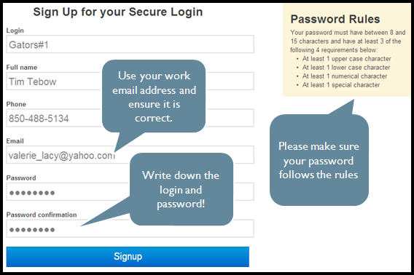
A. Creating an Account

Slide 6
A. Creating an Account
Go to your email and open the email from FleetHelpDesk
Click on the link. If the link is not underlined in blue, copy and paste it into your internet browser.

Slide 7
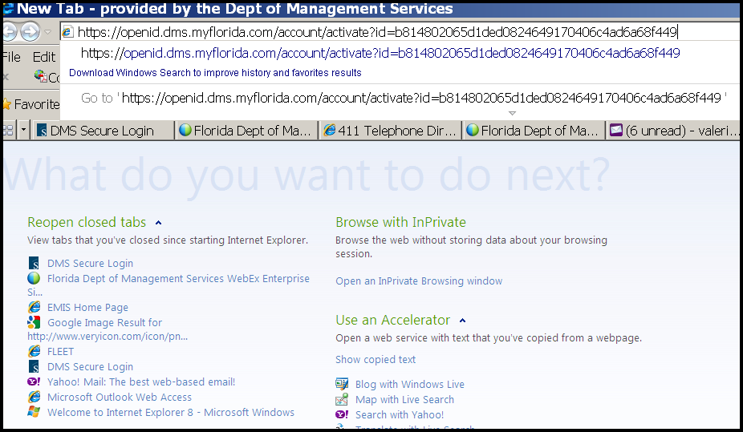
This is an example of copying and pasting into your internet browser.

Slide 8
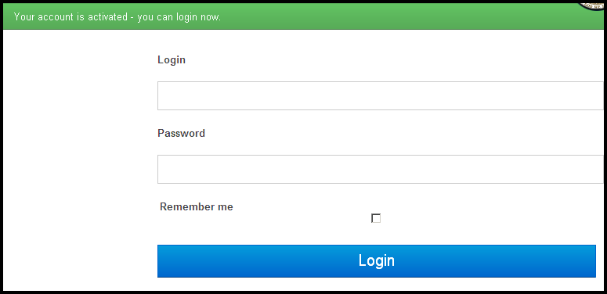
A. Creating an Account
Now simply log in with the user name and password you wrote down.

Slide 9
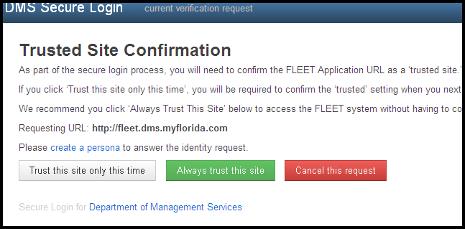
A. Creating an Account
Click “Always trust this site”

Slide 10
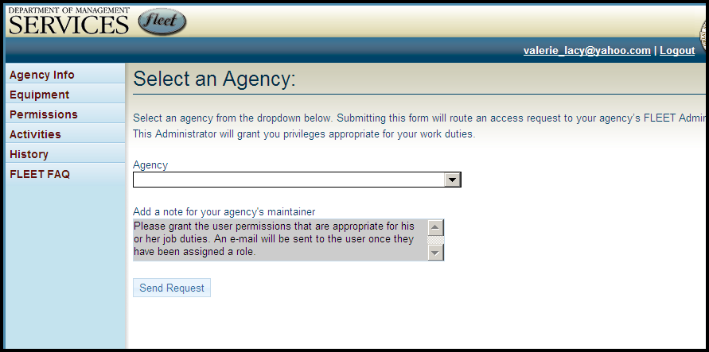
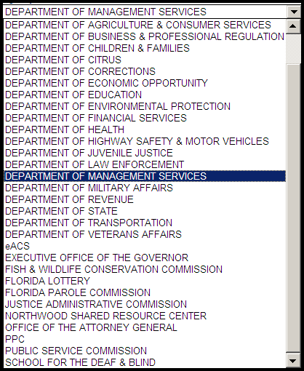
Choose your agency. If an agency is not chosen, you will not show up in the system.

Slide 11
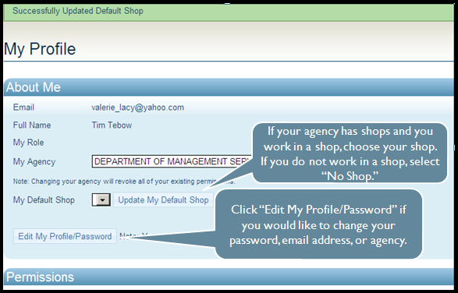
A. Creating an Account
Updating a Shop or Password

Slide 12
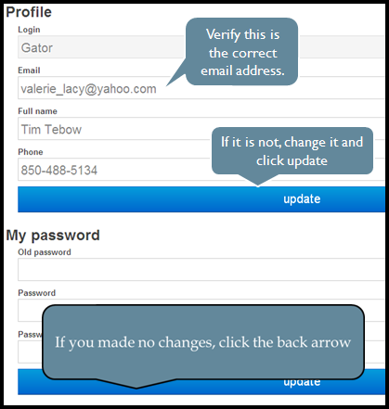
A. Creating an Account

Slide 13
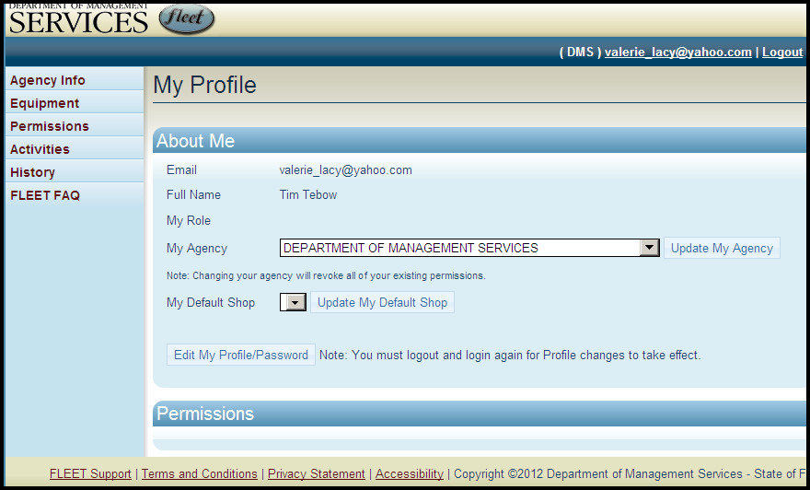
A. Creating an Account
Then click on agency info for your home page

Slide 14
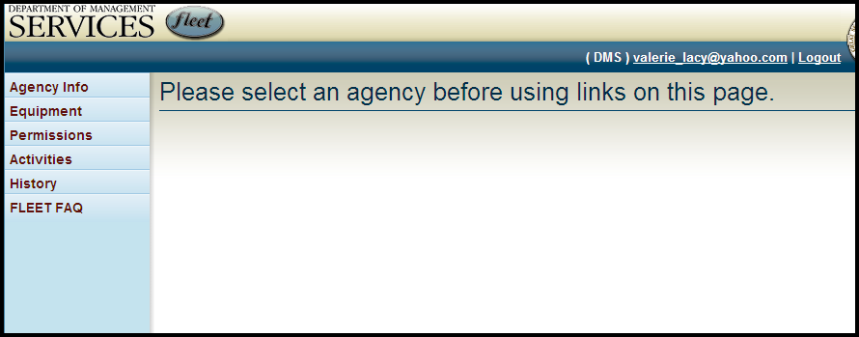
A. Creating an Account
Your screen will be blank, until your agency administrator assigns your user role.

Slide 15
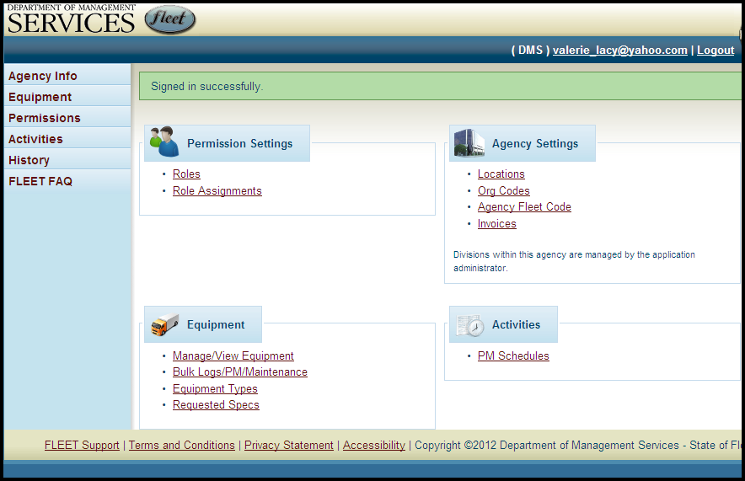
A. Creating an Account
After your agency assigns your role, the sign in is complete.

Slide 16
I. User Names & Passwords
Creating an Account
Forgot Password? (16-26)
Updating Email addresses or Passwords

Slide 17
B. Forgot Password?
Click Login

Slide 18
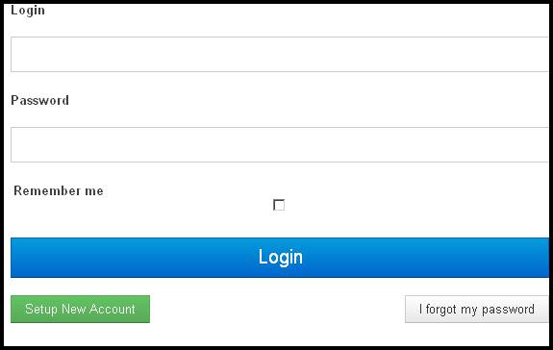
B. Forgot Password?
Click forgot my password

Slide 19
B. Forgot Password?
Enter your email address
You will receive an email, please type in your password as given to you.

Slide 20
B. Forgot Password?
If you copy/paste your password, make sure to delete the extra space at the end of the password after you paste it.
lRdLnBtL.82
You’ll notice when you copy the password there may be one or two extra spaces after the word. Delete those out after you paste it in.

Slide 21
I. User Names & Passwords
Creating an Account
Forgot Password?
Updating Email addresses or Passwords

Slide 22
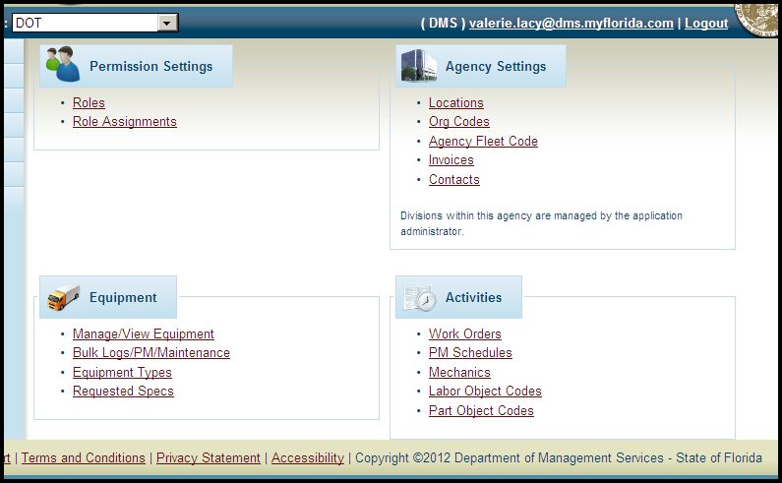
C. Updating Email/Passwords
Click on your email address at the top of the screen

Slide 23
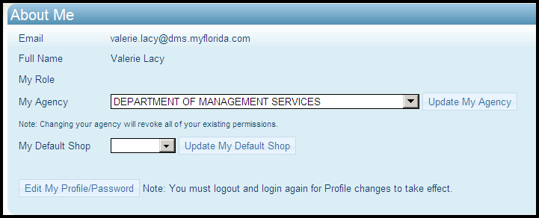
C. Updating Email/Passwords
If your agency is not correct, select your agency then click update my agency.
To change your email or full name, click edit my profile

Slide 24
C. Updating Email/Passwords
Only If your agency uses shops, set your shop #.

Slide 25
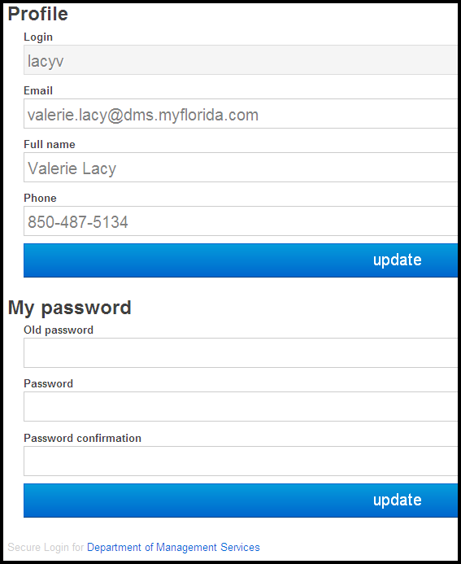
C. Updating Email/Passwords
Make sure your email, full name and phone # are correct. Then click update.
After updating the info below, change your password and click update here.

Slide 26
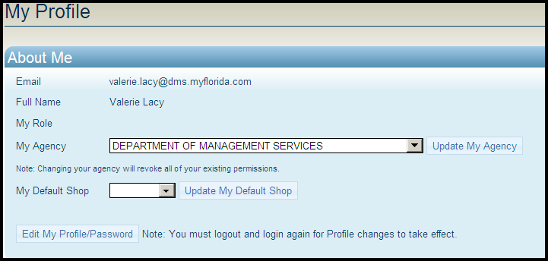
C. Updating Email/Passwords
That’s It!!

Slide 27
Part Two – Logs
User Names & Passwords
Creating an Account
Forgot Password
Updating Email Addresses or Passwords
Logs
Monthly Bulk Logs
Single Equipment Logs
Work Orders/PM’s
With Bulk Logs
With Manage/View Equipment
With Activities tab (ACS & DOT only)

Slide 28
II. Logs
Bulk Logs-Monthly/Bulk Logs
Single Logs-Manage/View Equipment

Slide 29
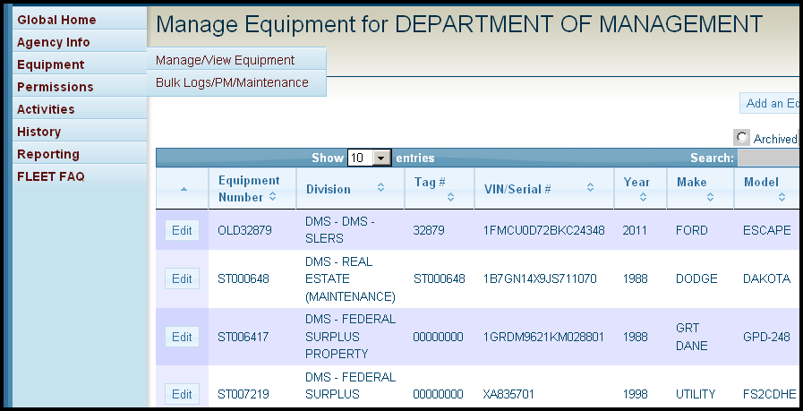
A. Monthly/Bulk Logs
Hover over the Equipment tab then click on Bulk Logs

Slide 30
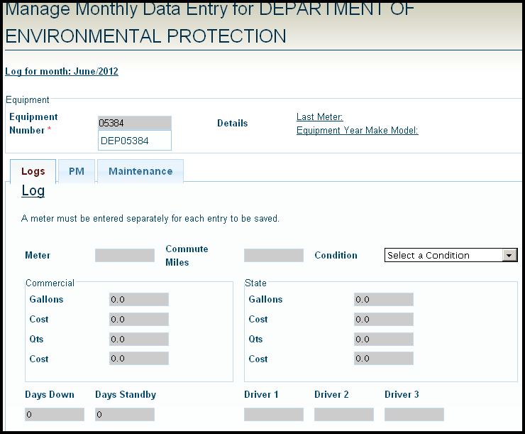
A. Monthly/Bulk Logs
Type in the #,
Then click on the right equipment and click tab

Slide 31
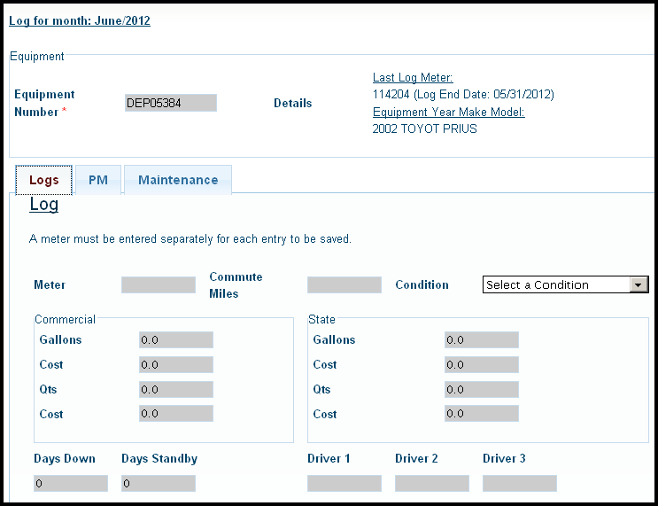
A. Monthly/Bulk Logs
If you need to enter another month, add log through manage/view equipment , instructions on page 35.
Verify you have the right piece of equipment
You can only enter logs for the recent previous month. For example, if today’s date is in July, I can only enter logs for June

Slide 32
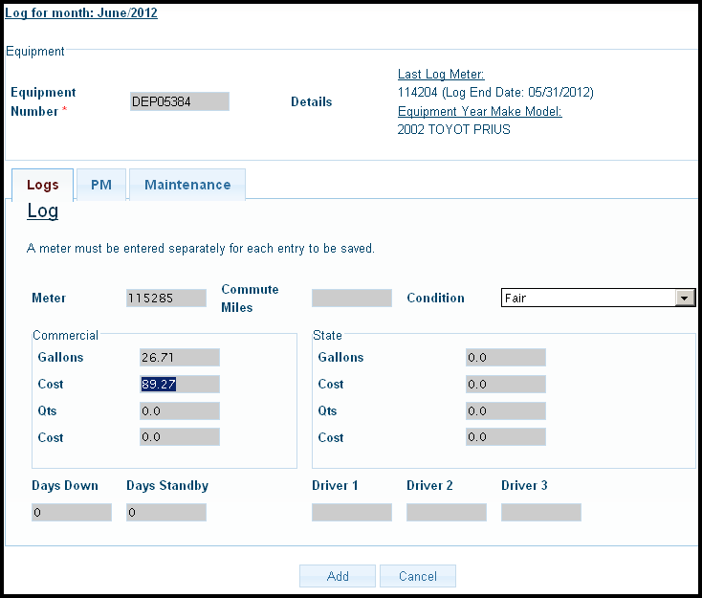
A. Monthly/Bulk Logs
Enter end of month meter, gallons, cost, condition, then click add.

Slide 33
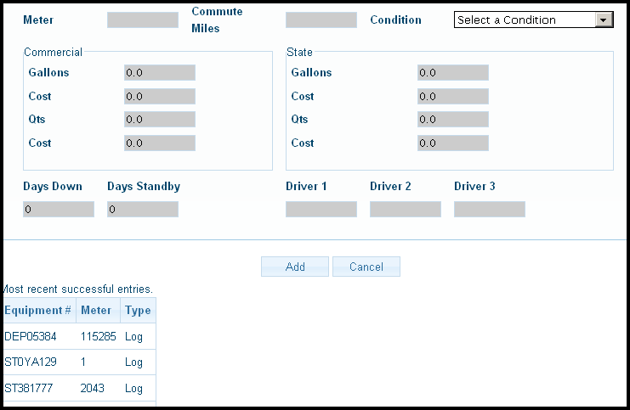
A. Monthly/Bulk Logs
Each log records as a list at the bottom of the page. Now you can enter your next monthly log.

Slide 34
II. Logs
Bulk Logs-Monthly/Bulk Logs
Single Logs-Manage/View Equipment

Slide 35
Manage/View Equipment
Hover over the Equipment tab then click on Manage/View Equipment

Slide 36
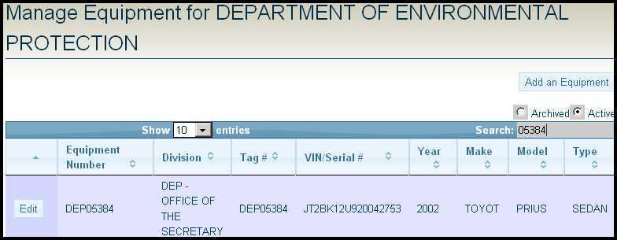
B. Manage/View Equipment
Type the equipment # in the search bar, then click edit.

Slide 37
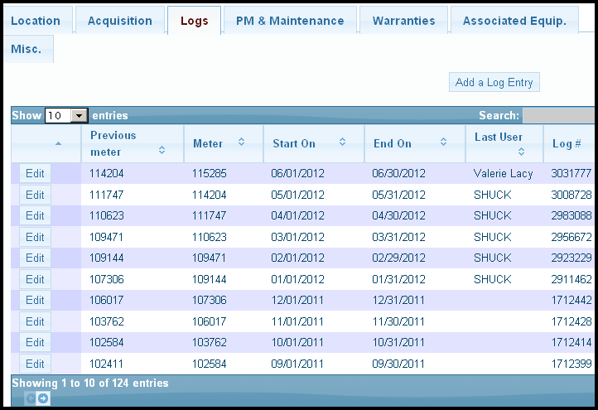
B. Manage/View Equipment
Scroll to the bottom and click on logs
Then click Add a Log Entry

Slide 38
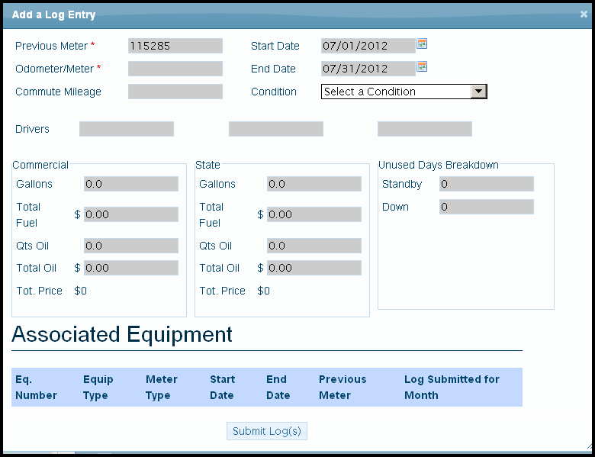
B. Manage/View Equipment
The date automatically populates, change it if you need to.
Check the previous meter, then enter end date meter reading
When you are done, click submit log.

Slide 39
Part Three
User Names & Passwords
Creating an Account
Forgot Password
Updating Email Addresses or Passwords
Logs
Monthly Bulk Logs
Single Equipment Logs
Work Orders/PM’s
With Bulk Logs
With Manage/View Equipment
With Activities tab (ACS & DOT only)

Slide 40
III. Work Orders/PM’s
Three Ways to Add Work Orders
Bulk Logs
Manage/View Equipment
Activities Tab (ACS & DOT only)

Slide 41
A. Bulk Logs
Hover over the Equipment tab then click on Bulk Logs

Slide 42
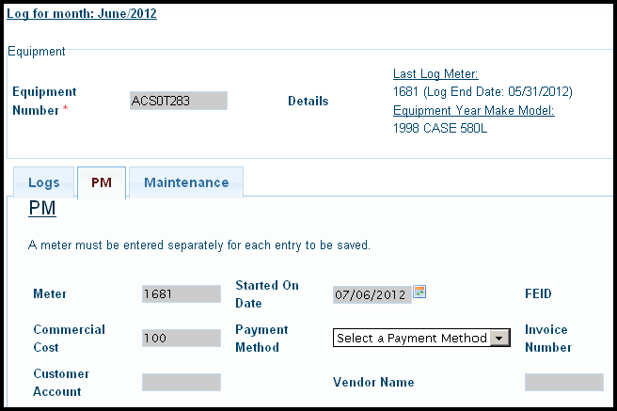
A. Bulk Logs PM Work Order
Click on PM and make sure to enter Meter, Cost, and date.

Slide 43
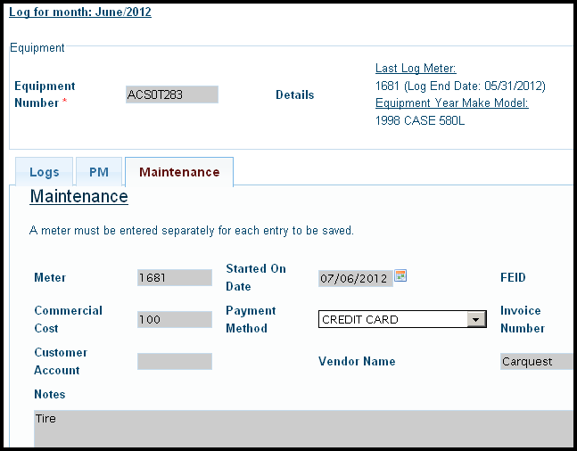
A. Bulk Logs Maintenance Work Order
Click on Maintenance. make sure to enter Meter, Cost, and date.

Slide 44
B. Manage/View Equipment
Hover over the Equipment tab then click Manage/View Equipment

Slide 45
B. Manage/View Equipment
Type in the equipment # then click Edit

Slide 46
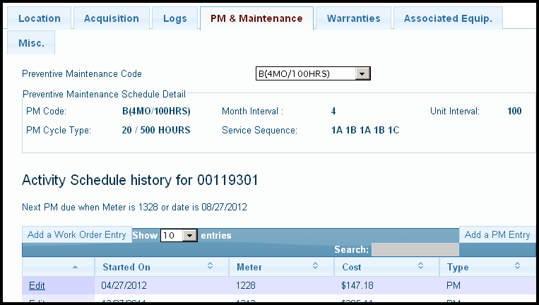
B. Manage/View Equipment PM
Scroll to the bottom and click on PM & Maintenance
Scroll to the bottom and click on PM

Slide 47
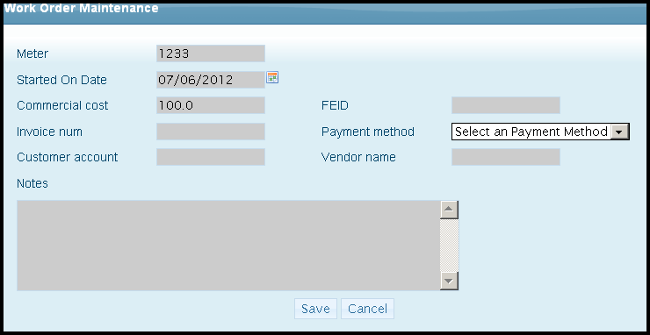
B. Manage/View Equipment PM
You must enter meter and date. After all info is entered, click save.

Slide 48
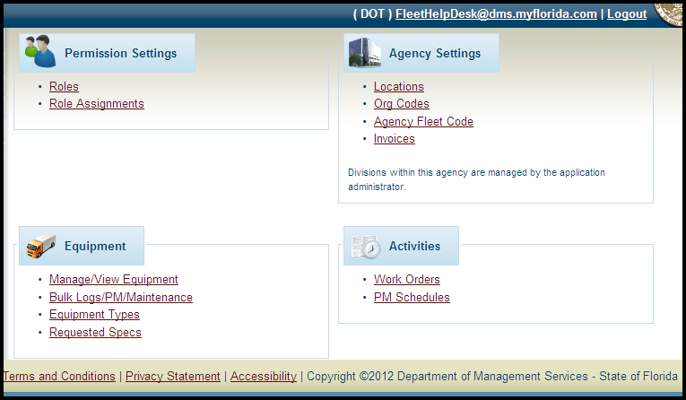
C. Activities Tab (ACS & DOT only)
Click Work Orders

Slide 49
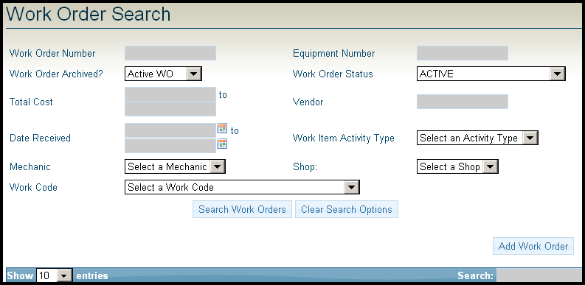
C. Activities Tab (ACS & DOT only)
Choose “select activity status”
To add a new work order, click here.
To edit an existing work order, use the search fields then click search.

Slide 50
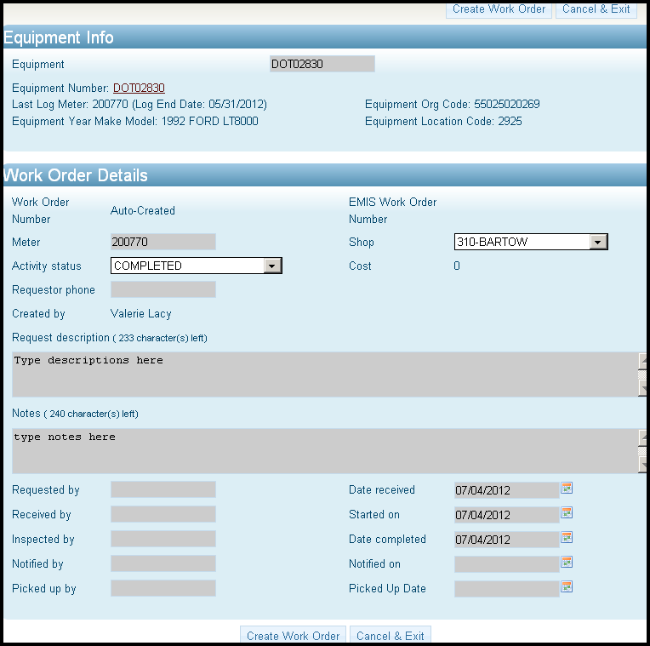
C. Activities Tab (ACS & DOT only)
Type in part of the equipment #
The Calendar pops up, just choose the date!
Click Create Work order to enter Items & Parts

Slide 51
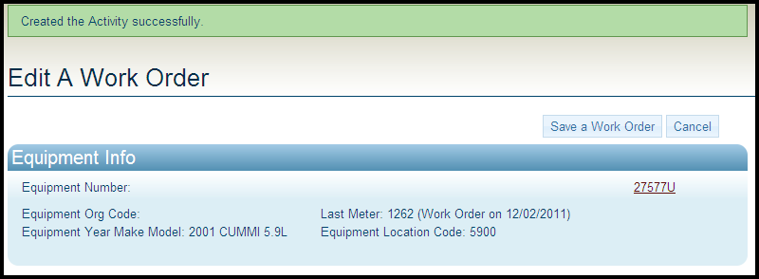
C. Activities Tab (ACS & DOT only)
The green bar at the top indicates the work order is successfully entered

Slide 52
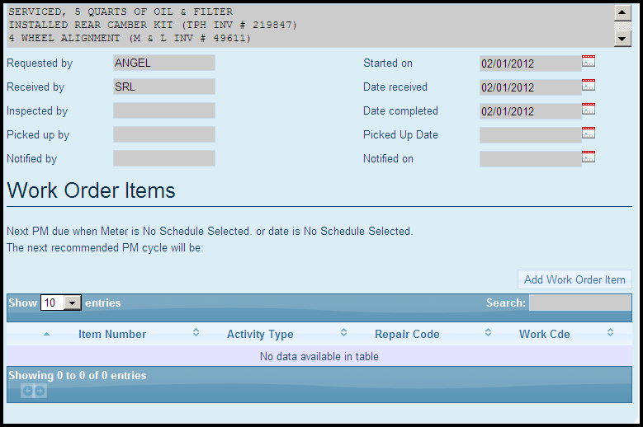
C. Activities Tab (ACS & DOT only)
Now you can add your work order items
Click Here

Slide 53
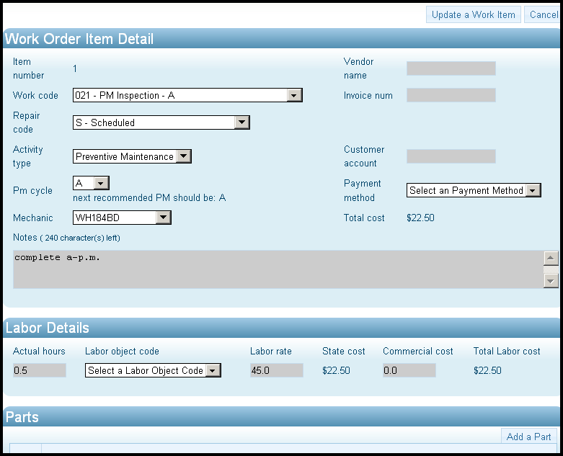
C. Activities Tab (ACS & DOT only)
Make sure to choose PM and cycle

Slide 54
C. Activities Tab (ACS & DOT only)
The Green Bar tells you the item is complete.

Slide 55
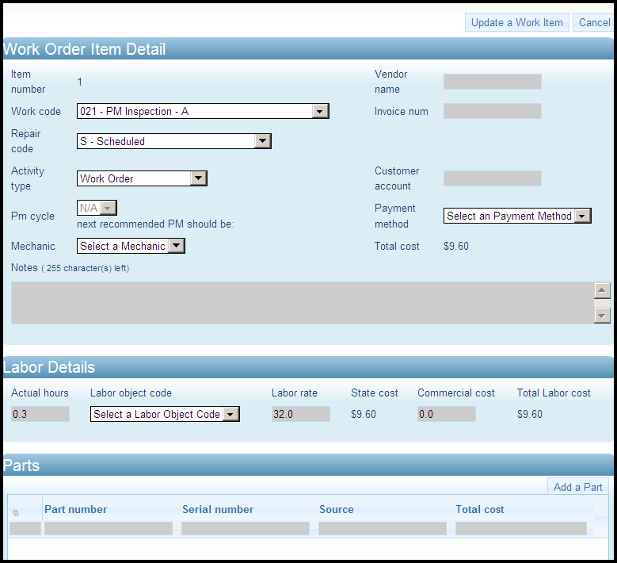
C. Activities Tab (ACS & DOT only)
Enter Parts if you have any. Then click Update a Work Item.
Click to add Parts

Slide 56
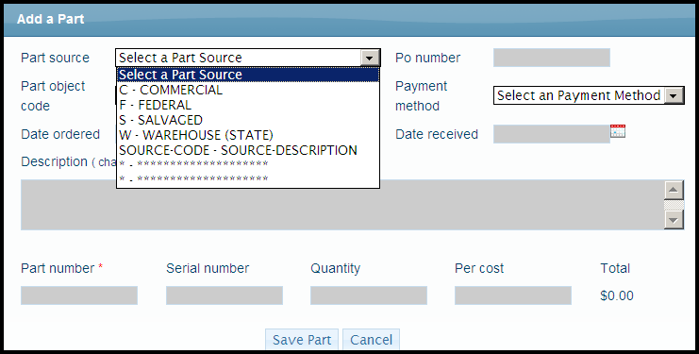
C. Activities Tab (ACS & DOT only)

Slide 57
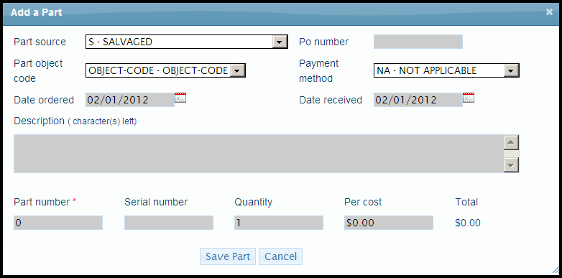
C. Activities Tab (ACS & DOT only)
Part will not save unless part number, quantity and per cost are entered
Click Save Part when done

Slide 58
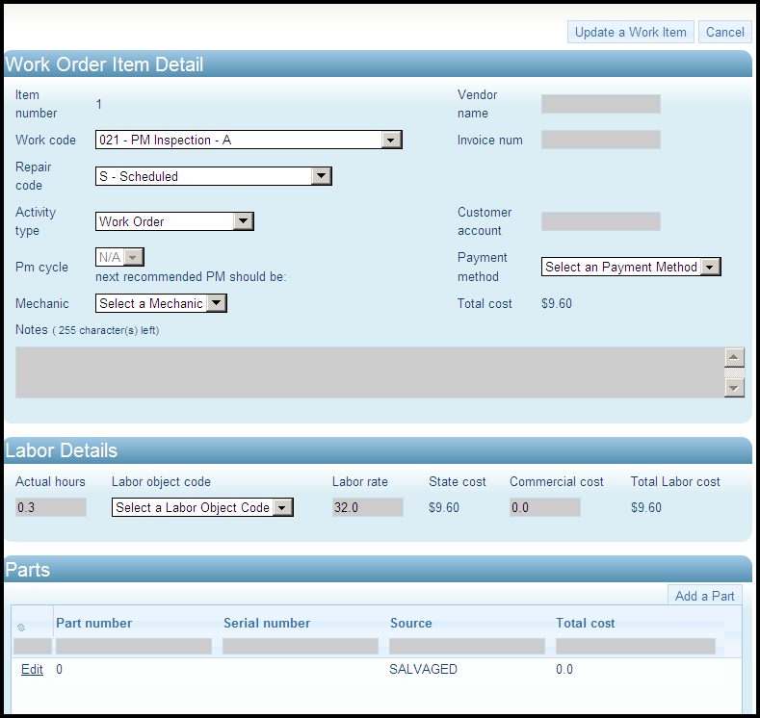
C. Activities Tab (ACS & DOT only)
Click to save item

Slide 59
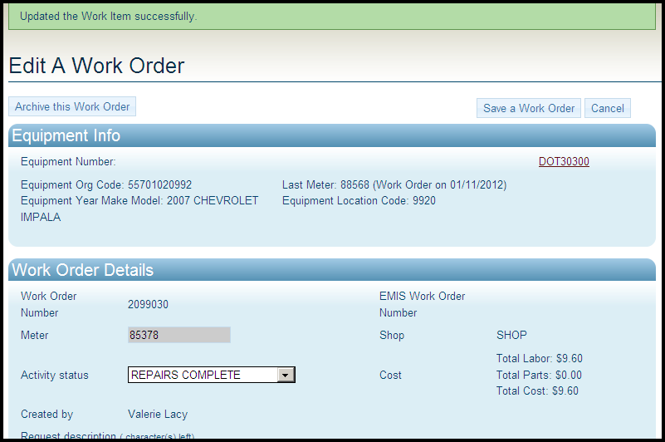
C. Activities Tab (ACS & DOT only)
Click to save work order

