Slide 2
The Family and Medical Leave Act Military Family Leave Provisions
Presented by the
U.S. Department of Labor
Wage and Hour Division

Slide 3
Disclaimer
The presentation is intended as general information only and does not carry the force of legal opinion.
The Department of Labor is providing this information as a public service. This information and related materials are presented to give the public access to information on Department of Labor programs. You should be aware that while we try to keep the information timely and accurate, there will often be a delay between official publications of the materials and the modification of these pages. Therefore, we make no express or implied guarantees. The Federal Register and the Code of Federal Regulations remain the official sources for regulatory information published by the Department of Labor. We will make every effort to keep this information current and to correct errors brought to our attention.

Slide 4
Introduction to the FMLA Military Family Leave Provisions
§ 825.101
Purpose:
Balance work and family life
Promote economic security of families and serve national interest in preserving family integrity
Shared Responsibilities:
Communication is key

Slide 5
Introduction to the FMLA Military Family Leave Provisions
Topics of Discussion:
Employer Coverage
Employee Eligibility
Military Family Leave Provisions
Qualifying Exigency Leave
Military Caregiver Leave
*This presentation specifically addresses the military leave provisions under the FMLA. For general FMLA information, please see the FMLA General PowerPoint.

Slide 6
Employer Coverage
§ 825.104
Private sector employers with 50 or more
employees
Public Agencies
Public and private elementary and secondary schools

Slide 7
Employee Eligibility
§ 825.110
Employed by covered employer
Worked at least 12 months
Have at least 1,250 hours of service during the 12 months before leave begins
Employed at a work site with 50 employees within 75 miles

Slide 8
FMLA Military Family Leave
The FMLA military family leave provisions include:
Qualifying exigency leave, which provides up to 12 workweeks of FMLA leave to help families manage their affairs when a military member has been deployed to a foreign country; and
Military caregiver leave, which provides up to 26 workweeks of FMLA leave to help families care for covered servicemembers with a serious injury or illness
Generally, FMLA rules and requirements continue to apply

Slide 9
Qualifying Exigency Leave
§ 825.126
Eligible employees may take up to 12 workweeks* of FMLA leave because of a qualifying reason that arises out of the fact that the employee’s spouse, son, daughter, or parent is on, or has been notified of an impending call, to “covered active duty”
For qualifying exigency leave, son or daughter refers to a son or daughter of any age
Leave for this reason counts against an employee’s normal FMLA entitlement for other leave reasons within the 12-month leave year
* Eligible airline flight crew employees are entitled to 72 days

Slide 10
Qualifying Exigency Leave – Covered Active Duty
§ 825.126
Regular Armed Forces:
duty during deployment of the member with the Armed Forces to a foreign country
Reserve components of the Armed Forces (members of the National Guard and Reserves):
duty during deployment of the member with the Armed Forces to a foreign country under a call or order to active duty in support of a contingency operation

Slide 11
Qualifying Exigencies
§ 825.126
Short-notice deployment (up to seven days)
Military events and related activities
Childcare and school activities
Financial and legal arrangements
Non-medical counseling
Care of the military member’s parent
Rest and recuperation (up to fifteen days)
Post-deployment activities (90-day period)
Additional activities by agreement

Slide 12
§ 825.309
Employee Responsibilities –
Provide Certification
An employer may require an appropriate certification with:
a copy of the military member’s active duty orders
a qualifying exigency certification (optional Form WH-384)
Statement of facts
Dates of leave
Frequency and duration of intermittent leave
Contact information for any third party meeting
The employer may verify meetings with a third party and may contact DOD to verify the military member’s covered active duty status

Slide 13
§ 825.127
Military Caregiver Leave
Eligible employees may take up to 26 workweeks* of FMLA leave in a “single 12-month period” to care for a “covered servicemember” with a “serious injury or illness” if the employee is the covered servicemember’s spouse, parent, son, daughter, or next of kin
For military caregiver leave, son or daughter refers to a son or daughter of any age
All FMLA leave is limited to a combined total of 26 workweeks during the “single 12-month period”; no more than 12 workweeks can be taken for other leave reasons
* Eligible airline flight crew employees are entitled to 156 days

Slide 14
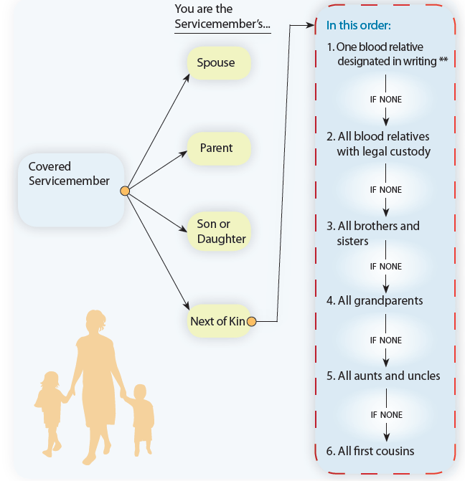
Qualifying Family Relationships Under Military Caregiver Leave
§ 825.127
**Designated for purposes of military caregiver leave under the FMLA.

Slide 15
Covered Servicemember
§ 825.127
A covered servicemember may be:
a current member of the Armed Forces; OR
a veteran of the Armed Forces.

Slide 16
Covered Current Servicemember
§ 825.127
A current member of the Armed Forces, including a member of the National Guard or Reserves:
undergoing medical treatment, recuperation, or therapy, is otherwise in outpatient status, or is otherwise on the temporary disability retired list, for a serious injury or illness

Slide 17
Current Servicemember – Serious Injury or Illness
§ 825.127
A serious injury or illness is one that:
was incurred by a servicemember in the line of duty on active duty; or
existed before the servicemember’s active duty and that was aggravated by service in the line of duty on active duty;
and
may cause the servicemember to be medically unfit to perform the duties of his or her office, grade, rank, or rating

Slide 18
Employee Responsibilities –
Certification for a Current Servicemember
§ 825.310
An employer may require that leave to care for a covered servicemember be supported by a certification completed by an authorized health care provider (optional WH-385), or an Invitational Travel Order (ITO) or Invitational Travel Authorization (ITA)
Authentication and clarification
Limited second and third opinions

Slide 19
Covered Servicemember - Veteran
§ 825.127
A veteran of the Armed Forces is a covered servicemember if he or she:
is undergoing medical treatment, recuperation, or therapy for a serious injury or illness; and
was discharged under conditions other than dishonorable within the five-year period before the employee first takes military caregiver leave*
* Special rules may apply if the servicemember was discharged before March 8, 2013

Slide 20
Veteran Serious Injury or Illness
§ 825.127
An injury or illness that was incurred or aggravated by service in the line of duty on active duty in the Armed Forces, that manifested before or after the servicemember became a veteran, and that is either:
a continuation of a serious injury or illness that was incurred or aggravated when the veteran was a member of the Armed Forces; or

Slide 21
Veteran Serious Injury or Illness
§ 825.127
(continued)
a condition for which the veteran has received a U.S. Department of Veterans Affairs Service-Related Disability Rating (VASRD) of 50 percent or greater (the rating may be based on multiple conditions); or
a condition that substantially impairs the veteran’s ability to work because of a disability related to military service, or would do so absent treatment; or
an injury that is the basis for the veteran’s enrollment in the Department of Veterans Affairs Program of Comprehensive Assistance for Family Caregivers

Slide 22
§ 825.310
Employee Responsibilities –
Certification for a Veteran
An employer may require that leave to care for a veteran be supported by a certification completed by an authorized health care provider (optional WH-385-V)
Authentication and clarification
Limited second and third opinions

Slide 23
§ 825.310
Employee Responsibilities –
Certification for a Veteran
An employee may submit a copy of a VASRD rating determination or enrollment documentation from the VA Program of Comprehensive Assistance for Family Caregivers to support the veteran’s serious injury or illness
Additional information may be needed to establish the other requirements for a complete certification such as:
confirmation of family relationship;
documentation of discharge date

Slide 24
Military Caregiver Leave – Application of Leave
§ 825.100, 825.127
Employee’s workweek is basis of entitlement
“Single 12-month period”
Per covered servicemember, per injury
Limitations on leave
26 workweeks for all qualifying reasons
Designation of caregiver leave
Spouses working for same employer

Slide 25
§ 825.200, 825.205 & 825.207
Military Caregiver Leave – Application of Leave
Intermittent Leave
Substitution of Paid Leave
“Substitution” means paid leave provided by the employer runs concurrently with unpaid FMLA leave and normal terms and conditions of paid leave policy apply
Employees may choose, or employers may require, the substitution of accrued paid leave for unpaid FMLA leave

Slide 26
Employer Responsibilities
§ 825.300, 825.301, 825.209, 825.210-213, 825.214-219 & 825.500
Provide notice
General Notice
Notice of eligibility
Rights & responsibilities
Provide notice of designation
Maintain group health insurance
Restore the employee to same or equivalent job and benefits
Maintain Records

Slide 27
Employee Responsibilities
§ 825.300, 825.305,
Notice requirements
Foreseeable leave
Unforeseeable leave
Provide certification
Provide periodic status reports

Slide 28
Other FMLA Leave Reasons
§ 825.112
Eligible employees may take FMLA leave:
For the birth or placement of a child for adoption or foster care
To care for a spouse, son, daughter, or parent with a serious health condition
For their own serious health condition

Slide 29
FMLA Enforcement Mechanisms
§ 825.400
To enforce FMLA rights, employees may:
File a complaint with Wage and Hour Division
File a private lawsuit (Section 107(a))
Action must be taken within two years after the last action which the employee contends was in violation of the Act, or three years if the violation was willful

Slide 30
FMLA Compliance Assistance Materials
Title I of the FMLA, as amended (29 U.S.C. 2601—2654)
The Regulations (29 C.F.R. Part 825)
The Employee’s Guide to the FMLA
The Employee’s Guide to Military Family Leave under the FMLA
FMLA Forms
FMLA Fact Sheets
FMLA Poster (WH-1420)
FMLA Frequently Asked Questions
FMLA elaws Advisor

Slide 31
Additional Information
Visit the WHD homepage at: www.wagehour.dol.gov
Call the WHD toll-free information and helpline at
1-866-4US-WAGE (1-866-487-9243)
Call or visit the nearest Wage and Hour Division Office

